Slide 1

STARTS BLURRY
A HEART BEAT IS HEARD AS IT UNBLURS REVEALING THE IMAGE

Slide 2
Find a nice transition for text – cant find an AI voice that works so no voice
Daughter

Slide 3
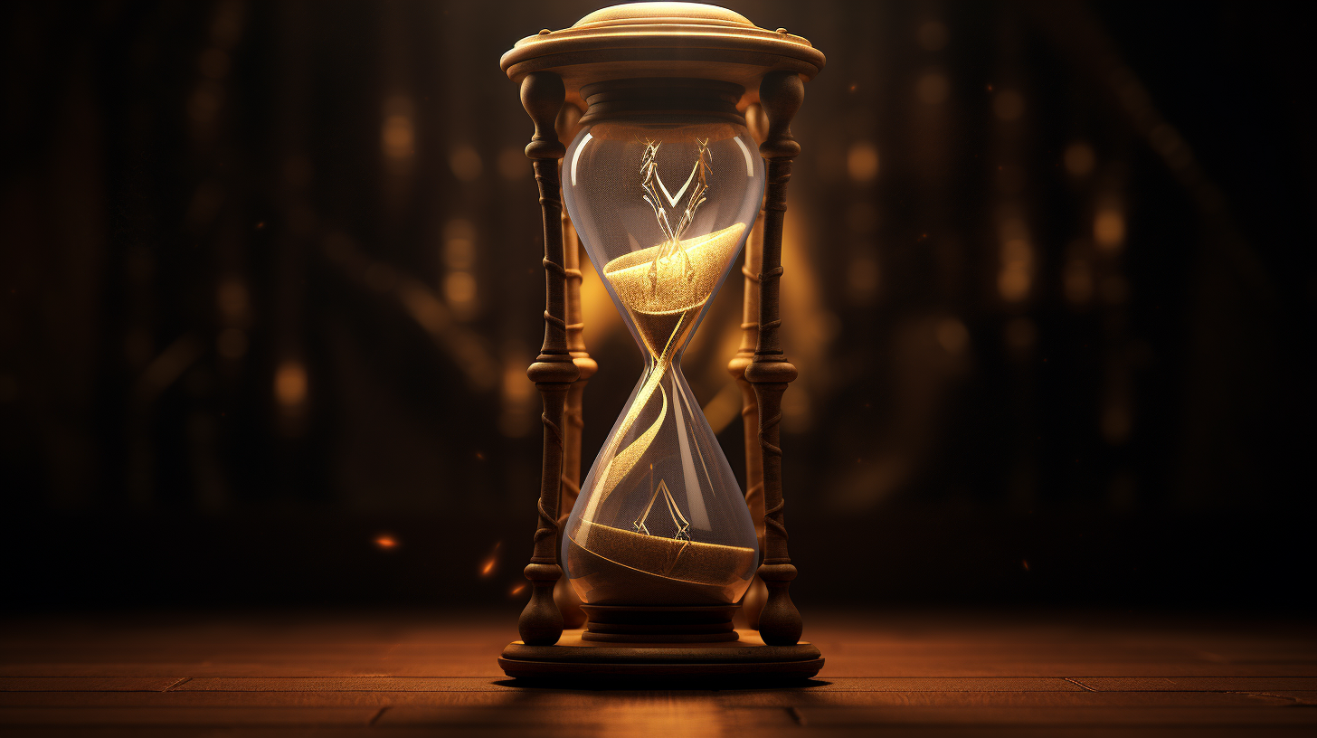
Alternate very quickly between images of the glass and the old woman
The effect is meant to feel like it’s a flashing distortion
Start playing the music

Slide 4
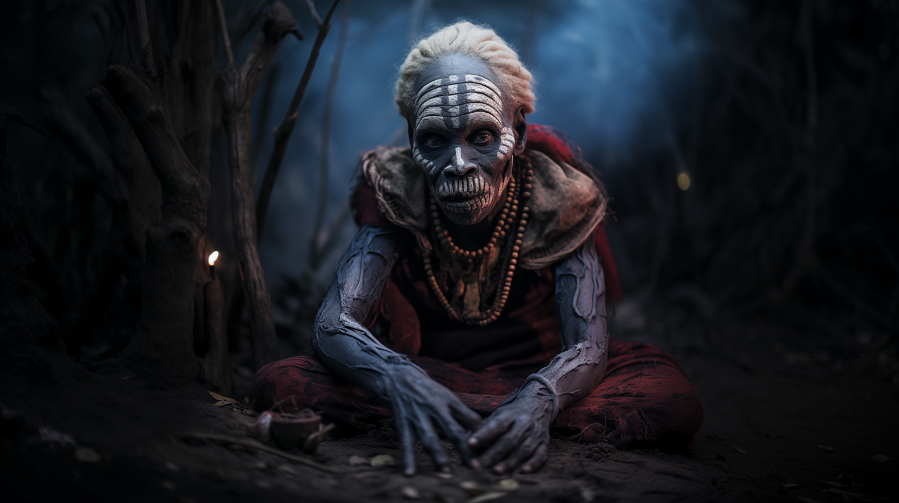
Prepare

Slide 5


Slide 6

Guilt

Slide 8

Is paid

Slide 9


Slide 10
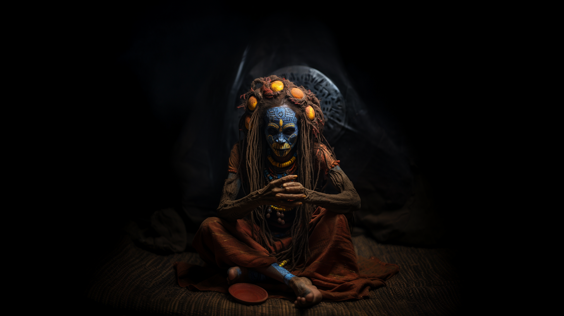
With

Slide 12
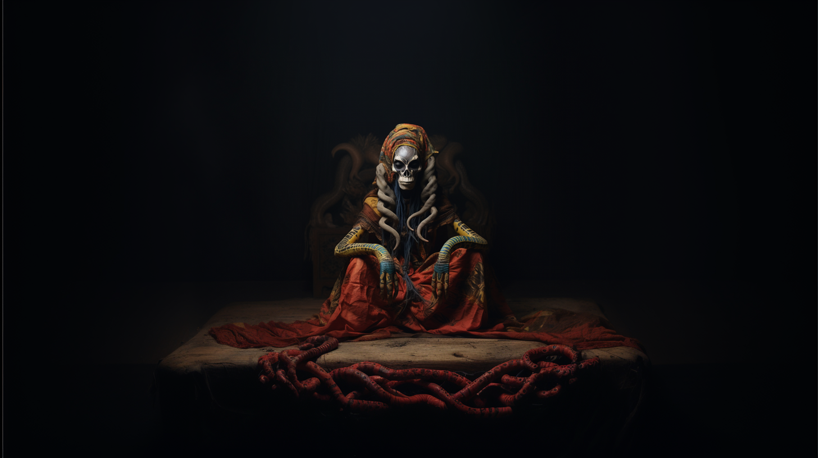
BECOMES BLURRY
Pain

Slide 13
PLAY THE START SCREEN VIDEO

Slide 14
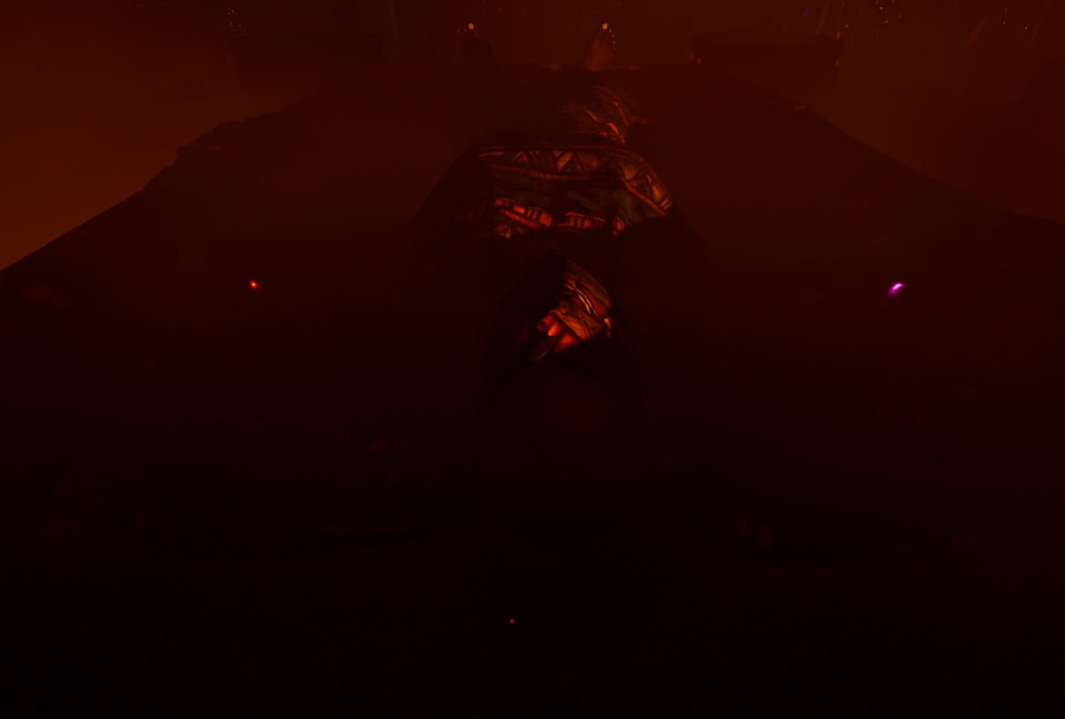
Aftyer the video finishes – quickly transition between these pics

Slide 15
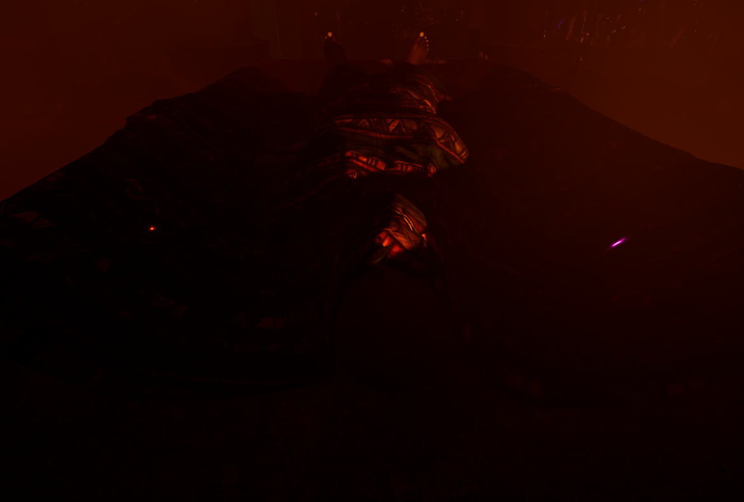
Search

Slide 16
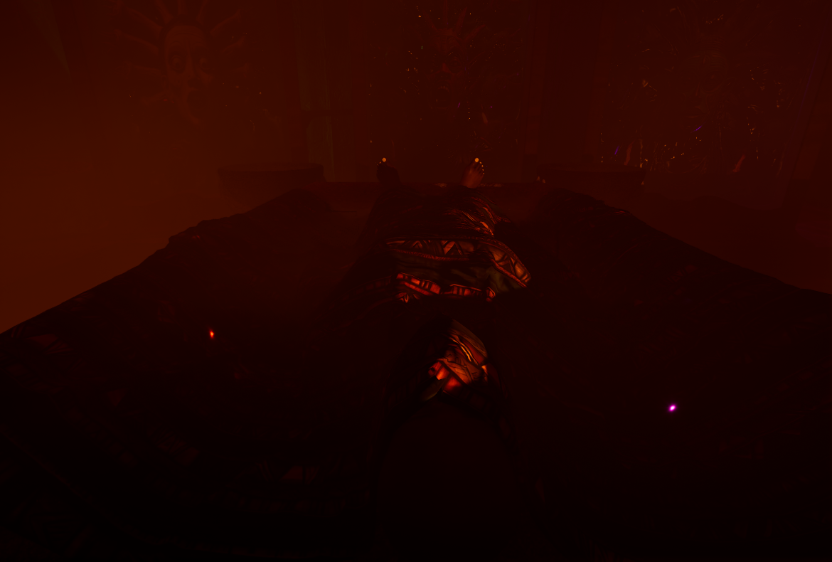

Slide 17
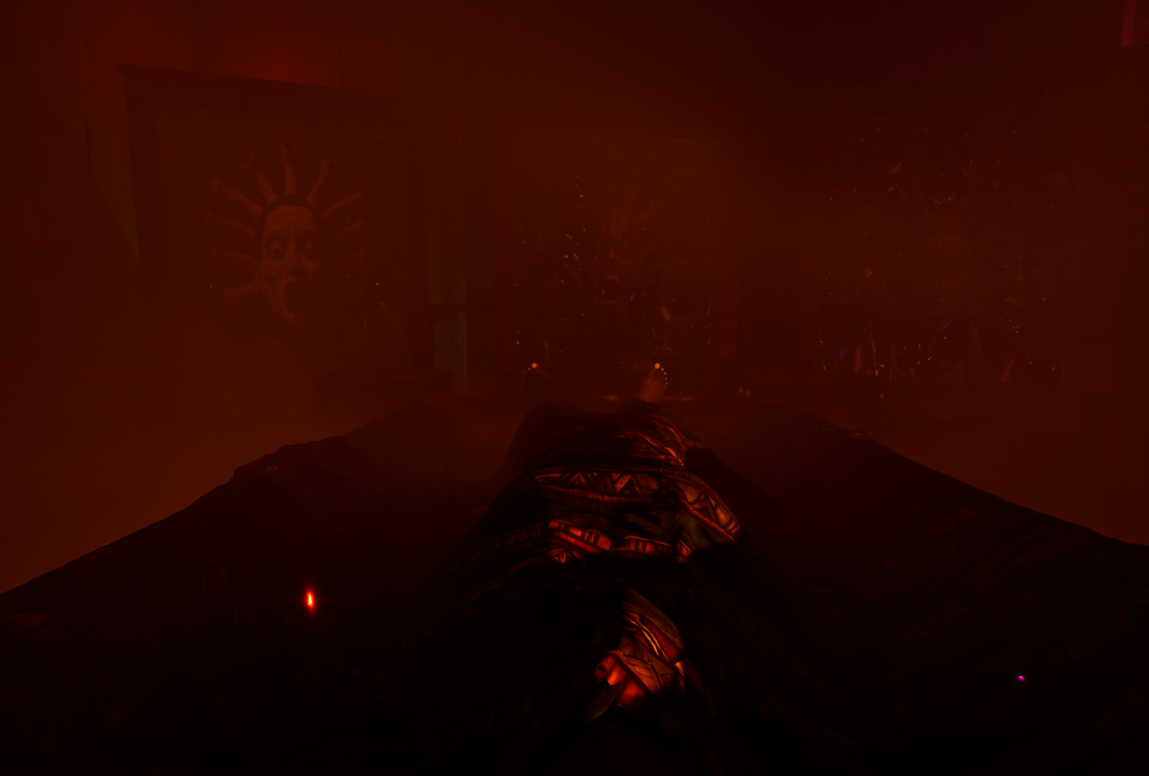

Slide 18
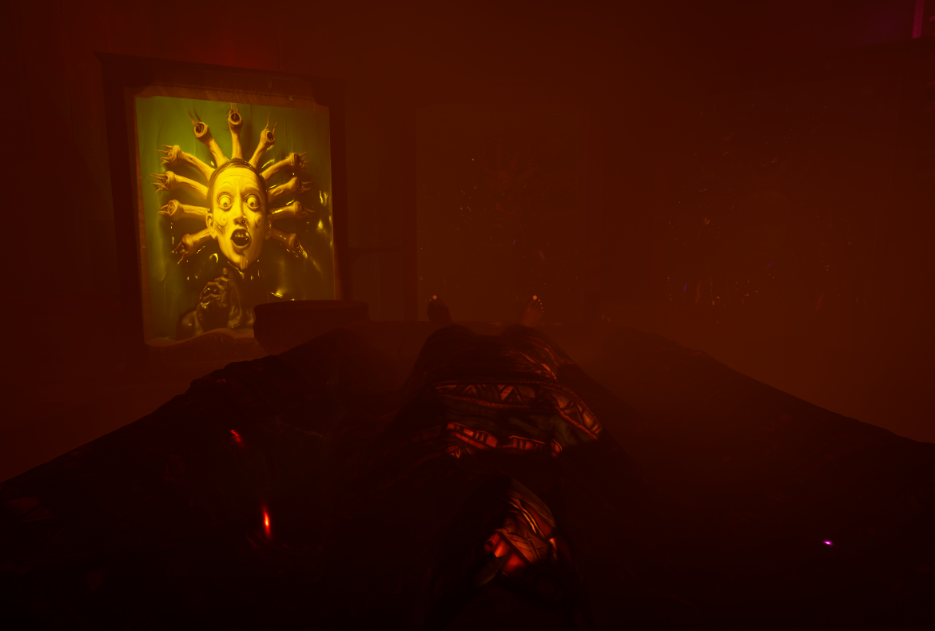

Slide 19
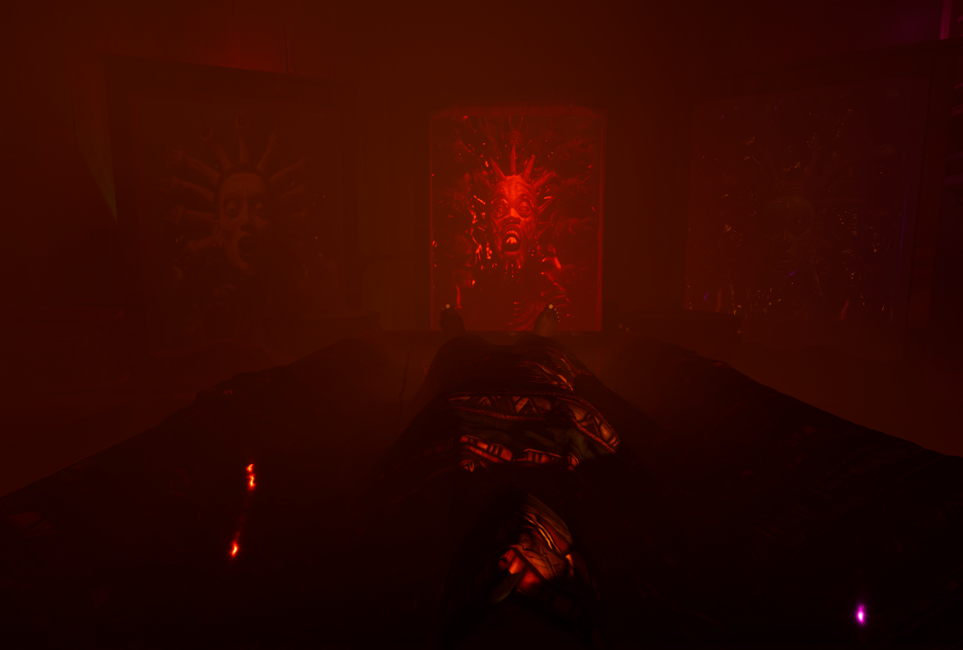

Slide 20
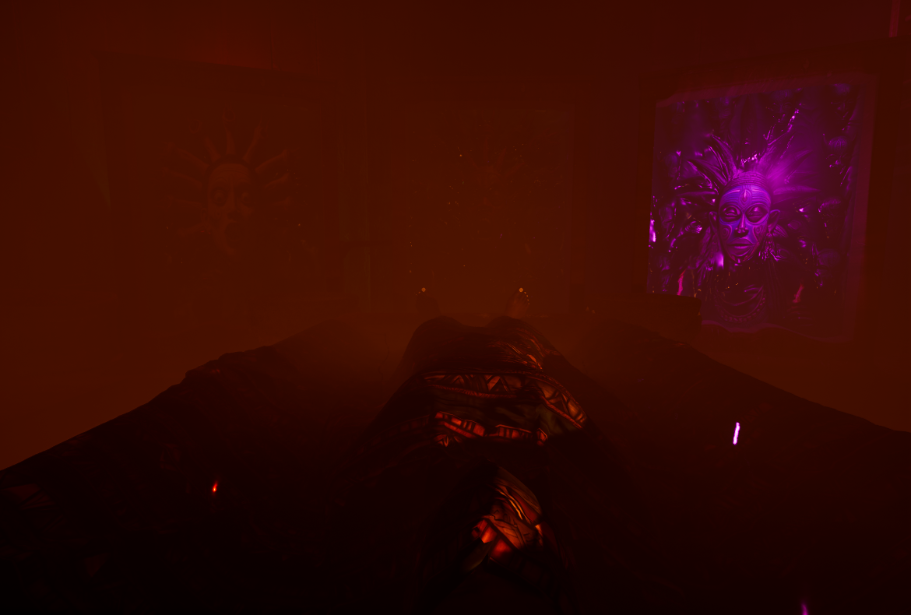

Slide 21
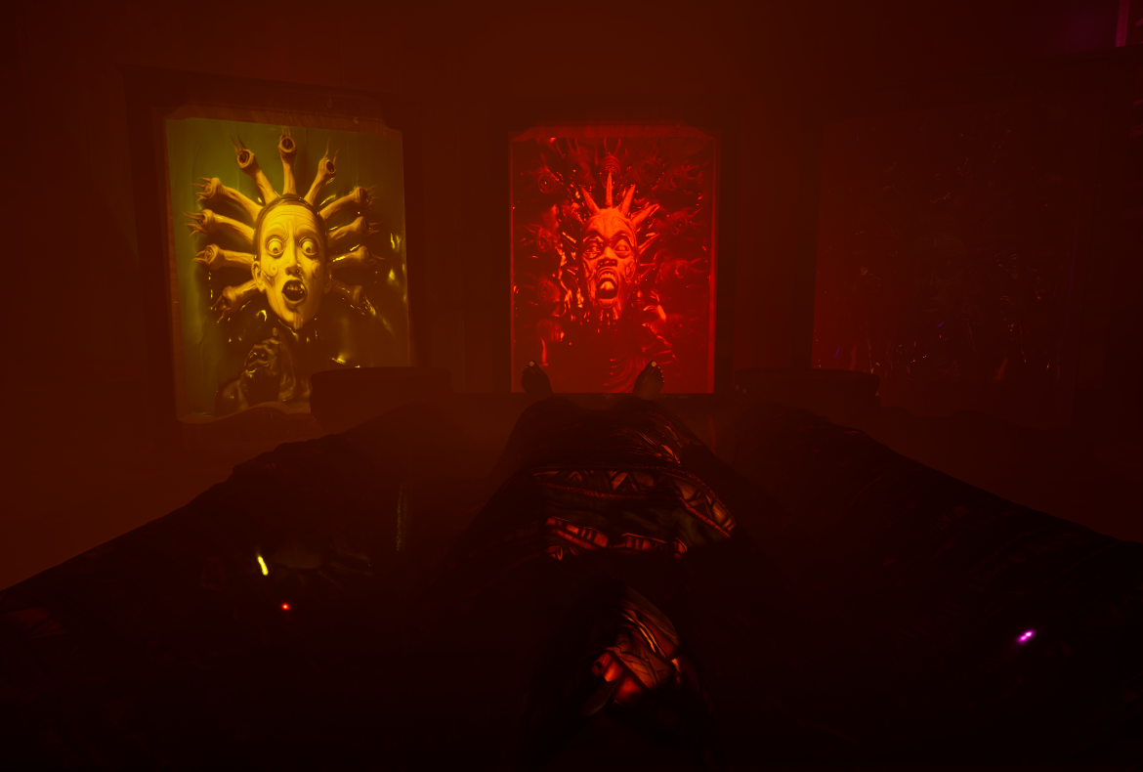
Lie

Slide 23
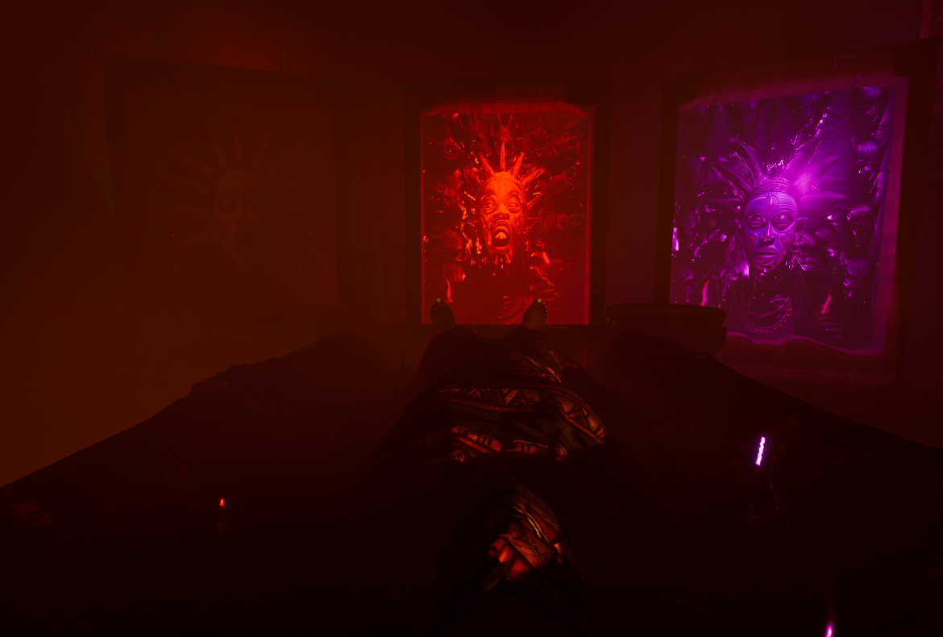

Slide 24
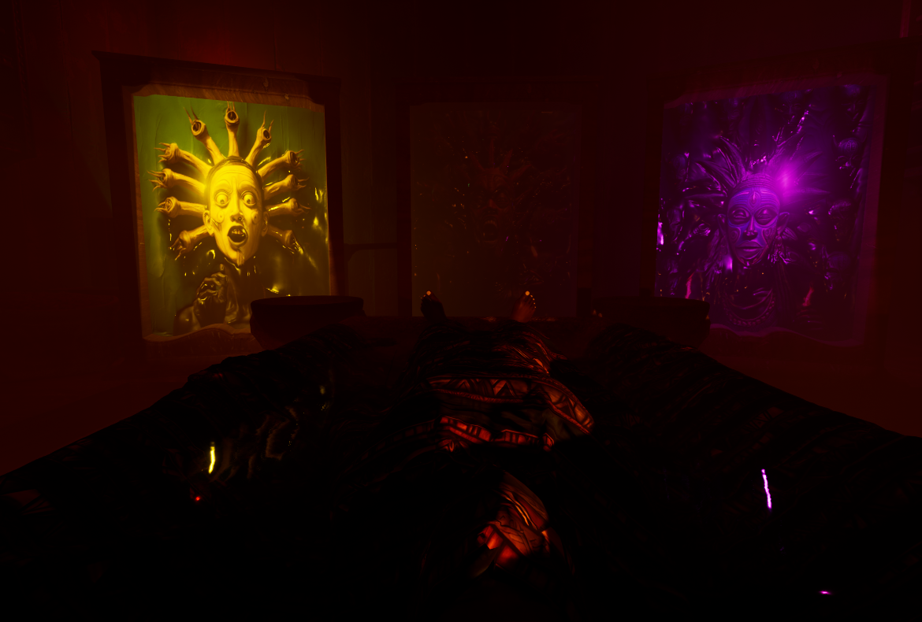

Slide 25
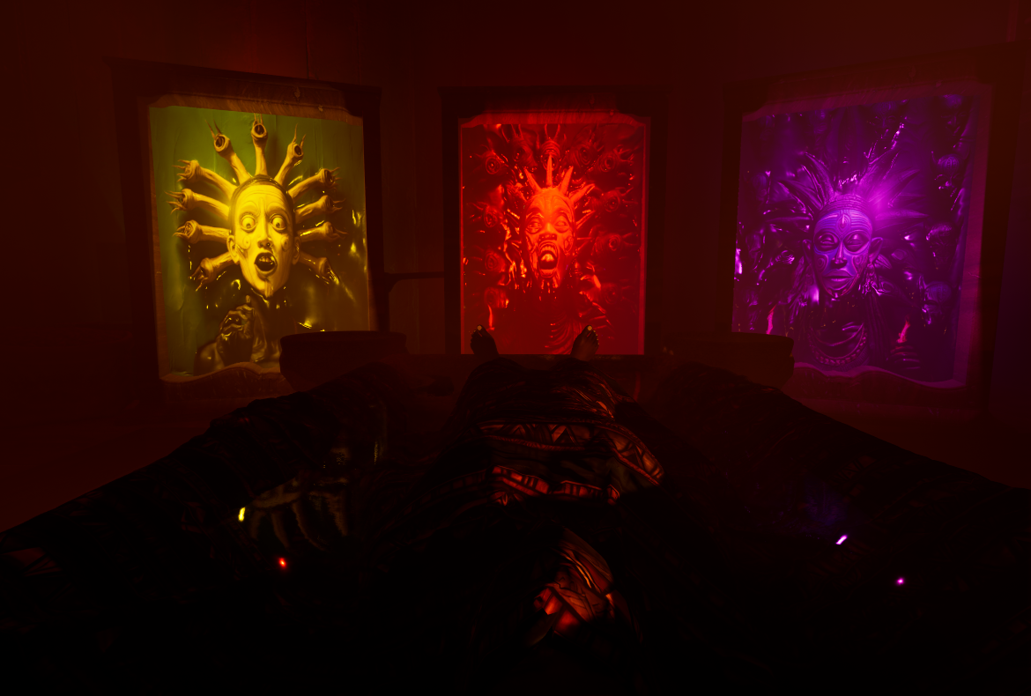
Fight

Slide 26
FLIGHTCLIP2 0.03 – 0.07
FLIGHTCLIP1 0.05 – 0.09
FLIGHTCLIP3 0.00 – 0.04

Slide 28
The

Slide 30
Cycle

Slide 32
Begins

Slide 34
Again

Slide 35
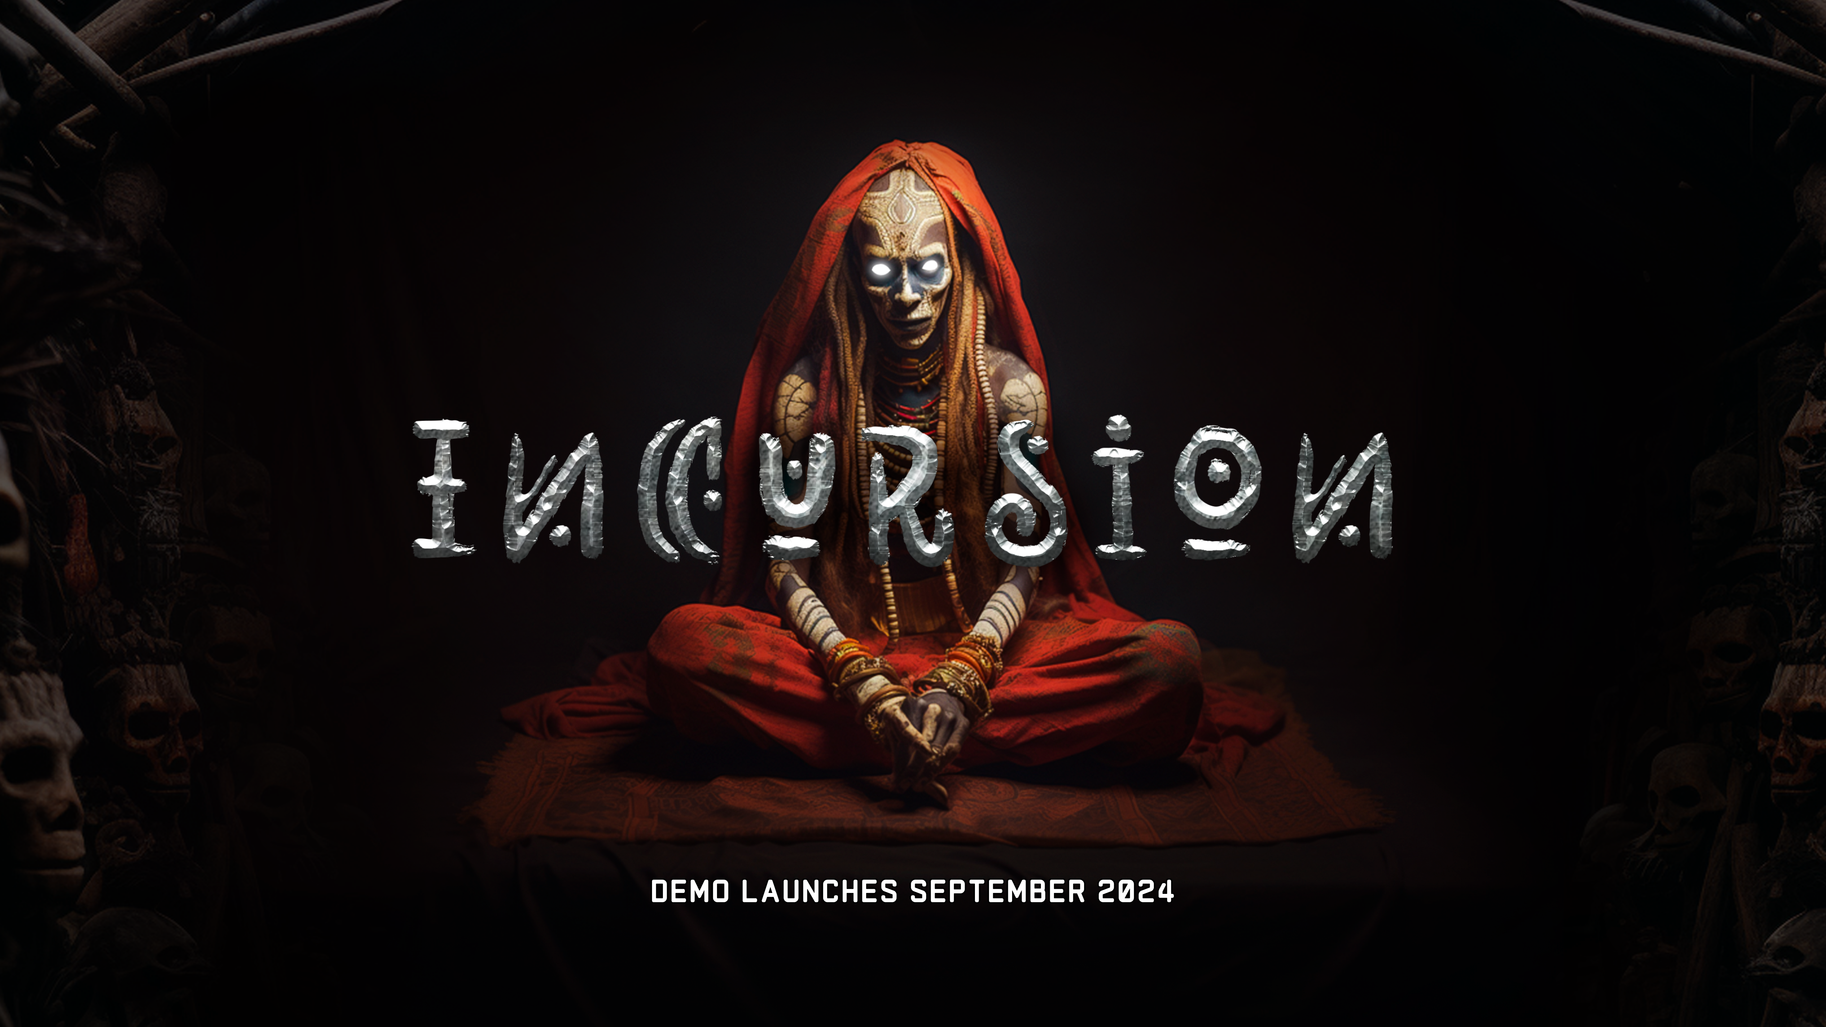
Again

